Slide 1
Mail Simulation Application Development

Slide 2
Mail Simulation Application Development
BY :
Hari Vakkala
Akshata G. Nayak
Anitha Ramapuram
Deepesh Kumar Khandelwal
Ranjeet Kumar Jha
Ramesha

Slide 3
Problem Statement
People use to communicate through letters and telegram which is not faster . So mailing system got introduced to over come this problem .
Mail Simulation Application is an application where user can interact with each other through mail .

Slide 4
Objective
To simulate mailing system so users can communicate easily . This application will have users and those users can communicate through mail .
This will reduce time and increase efficiency

Slide 5
Technology And Tools
Technologies
Backend
Spring Boot With Hibernate
Frontend
Angular 7.0
Tools
Eclipse IDE 2019-09
Visual Studio Code

Slide 6
Modules
Register
Login
Change password
Sent Mail
Compose Mail
Inbox
Delete
Draft
Home

Slide 7
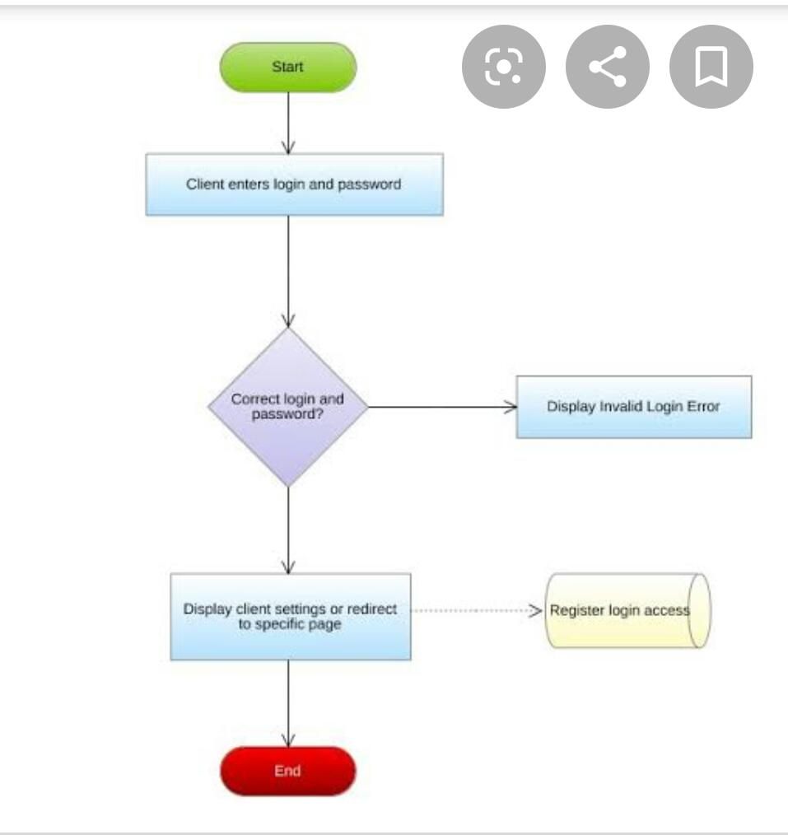
FlowChart

Slide 8
Roles
Hari Vakkala : Register component and Service part
Akshata G. Nayak: Login component , Forgot Password and HomeComponent.
Anitha Ramapuram : Documentation and compose
Deepesh Kumar Khandelwal : Changepassword component and Controller part
Ranjeet Kumar Jha : Sent component and dao part
Ramesha : Back end and Front end with both integration Part and Bean class and UserHome component

Slide 9


